Slide 1
Cognisess Hackathon 2021
To improve the way we look for and apply for jobs.
Our project aims to assist people in finding their ideal job role through a more interactive, more-rounded search process.
Job seeker
Ideal job
Matched

Slide 2
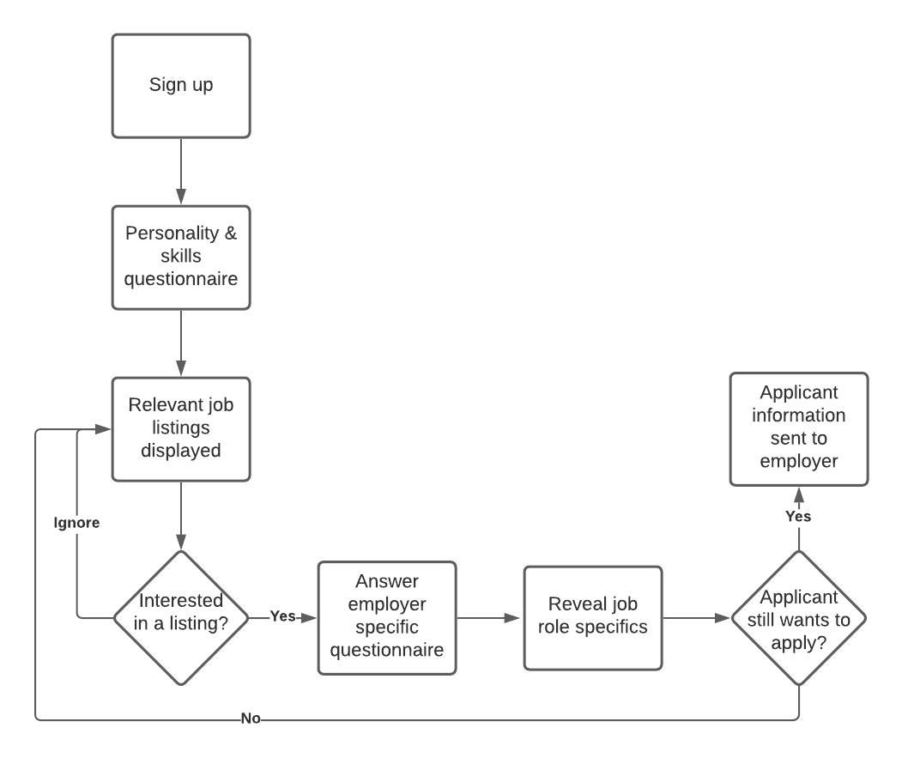
Flow Chart

Slide 3
Project Demo

Slide 4
Why is this project necessary?
We envision our project cutting the time it takes for an applicant to find jobs that suit them.
Employers are also given a brief overview of each candidate’s personalities which they can then also take into account when deciding to carry them forward in the application process or not.
Our approach matches job seekers with a role that matches their interests, skills and personality as opposed to the regular methods of filtering by sector or searching keywords. This could potentially lead to someone applying for a job they otherwise wouldn’t have even found.

Slide 5
Future Developments

Slide 6
Thank you for listening!

